Slide 1
Tissues
Year 11 Human Biology
ATAR
PowerPoint #6

Slide 2
SCSA Syllabus Reference
The various tissues of the human body perform specific functions and can be categorised into four basic tissue types: epithelial, connective, muscular and nervous

Slide 3
Lesson Intention
To describe the specific functions of different tissue types

Slide 4
Success Criteria
define tissue
identify the different types of tissues
describe the structure of each tissue type
describe the specific function for each type of tissue
provide examples of each tissue type

Slide 5
Vocabulary
Tissue: a group of cells that are similar in structure and function.
Epithelium: tissue that forms the outer part of the skin and that lines hollow organs and ducts; a covering tissue.

Slide 6
Vocabulary
Connective tissue: tissue providing support for body organs
Muscular tissue: tissue made up of muscle cells
Nervous tissue: tissue made up of nerve cells (neurons)

Slide 7
Tissues
The structure of the tissue and the function it performs can be used to classify it into one of four basic types
Epithelial
Connective
Muscular
Nervous

Slide 8
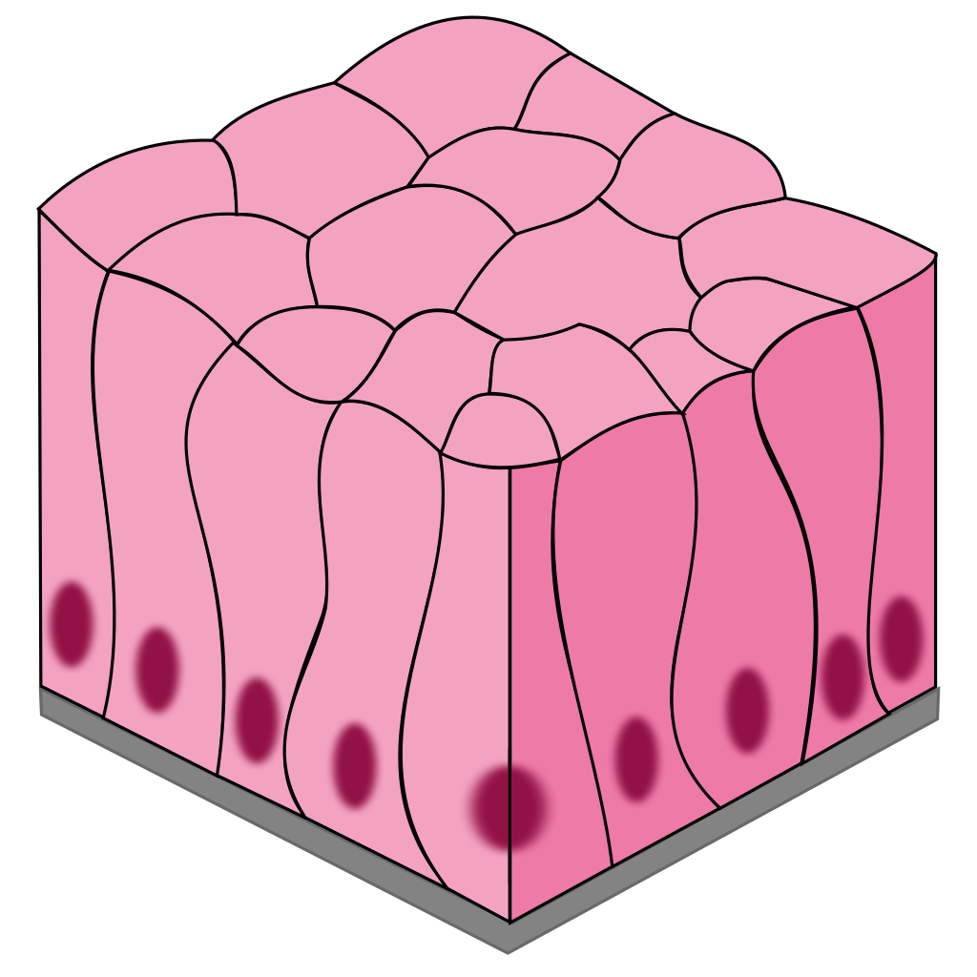
Epithelial tissue
Is a covering or lining tissue e.g. outer layer of the skin
The cells that make up epithelium are very closely joined together.
They vary in shape from thin and flat to
column-shaped and cubed-shaped.

Slide 9
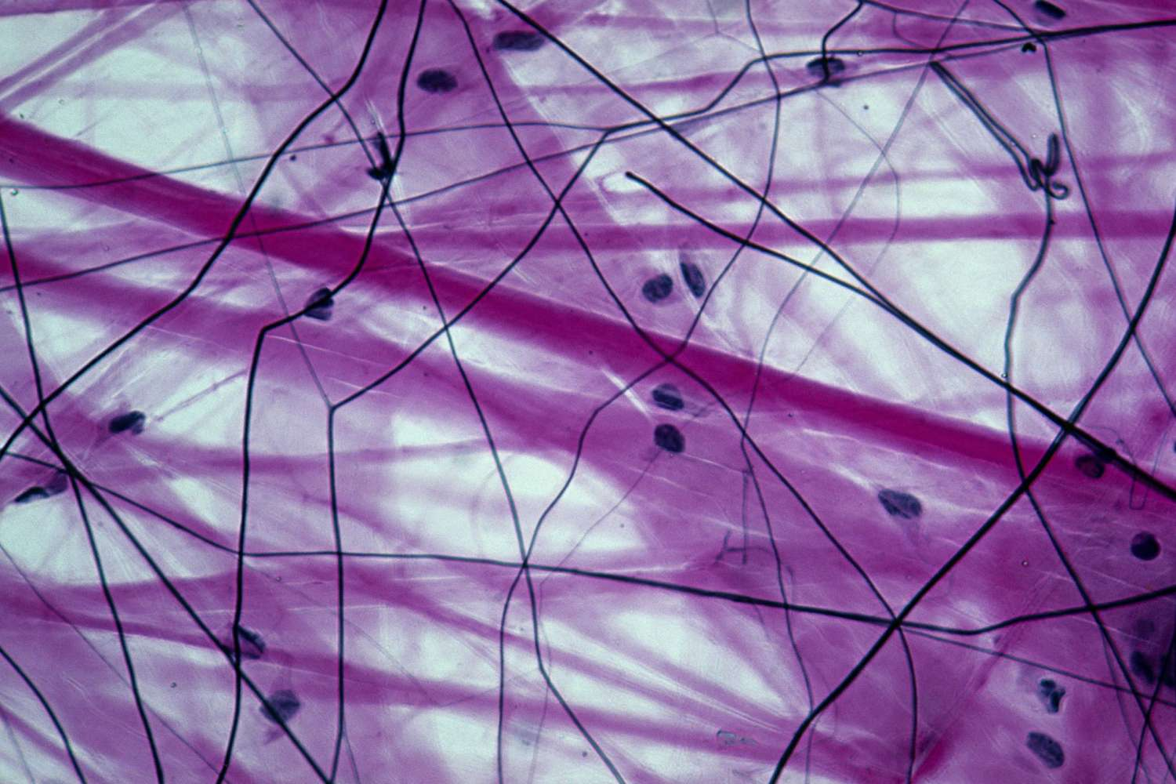
Connective tissue
Provides support for the body
The cells are not close together like they are in epithelium. They are separated from each other by large amounts of material that is not made of cells. This non-cellular material is called matrix.
Connective tissue includes bone, cartilage, tendons, ligaments and fat storage tissue. Blood is often classified as a connective tissue. The matrix (non-cellular material that separates the cells in connective tissue) of blood is the liquid in which blood cells are suspended.

Slide 10
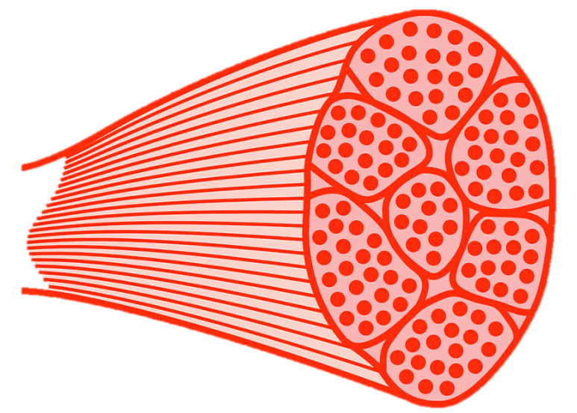
Muscular tissue
The cells of muscular tissue are often called muscle fibres.
They are long and thin and can contract to become shorter.
There are three types:
Skeletal
Smooth
Cardiac

Slide 11
Skeletal muscle
Makes up muscle that are attached to bones
These are the muscles you feel in your arms and legs
We have voluntary control over these muscles, so it is sometimes called a ‘voluntary muscle’.
Skeletal muscle fibres are seen to have stripes, or striations, across them.

Slide 12
Smooth muscle
Does not have any striations.
Found in the walls of the stomach and intestines
We cannot contract smooth muscle voluntarily, therefore it is sometimes called ‘involuntary muscle’.

Slide 13
Cardiac muscle
Also known as heart muscle, makes up most of the heart.
When heart muscle contracts, it pumps the blood.
It cannot be controlled voluntarily.

Slide 14
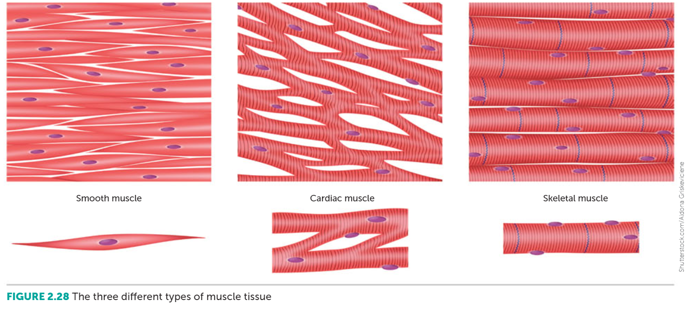

Slide 15
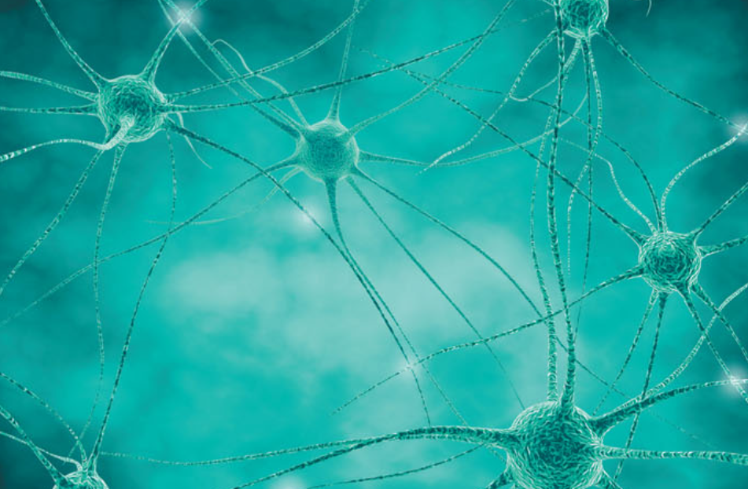
Nervous tissue
Made up of specialised nerve cells called neurons.
Have long projections from the body of the cell.
When part of a neuron is stimulated, messages can be carried along these projections from one part of the body to another.
Nervous tissue is found in the brain, spinal cord and the nerves.

Slide 16
Recall Knowledge
What type of tissue is bone?
Define tissue.
What are nerve cells called?

Slide 17
Apply Knowledge
Explain why the cells in epithelial tissue are closely packed together.

Slide 18
Homework
Explain the differences in function between the three types of muscle tissue.

Slide 19
Reading
Pages 43 (bottom half) - 46 (top half): Tissues

